Slide 1
Malaysia - Librarians’ Competencies
LIS Education & Curriculum
27 June 2011 : UI
2 Julai 2011 : UGM
Nor Edzan Che Nasir
Library
University of Malaya

Slide 2
Numerous reports, proposals and mechanisms available referring to competencies of librarians
4 in place
A. Perpustakaan Negara Malaysia. 2003. Laporan Kajian Keperluan Sumber Manusia dalam Bidang Perpustakaan dan Perkhidmatan Makumat di Malaysia. Kuala Lumpur: PNM, 2004.
For the duration 1999 to 2003 for 2004-2008
368 libraries – 15 public university libraries involved
identified 4 categories of competency
  Management & administration
  ICT skills
  Professional knowledge & skills
  Personal relationship

Slide 3
in the survey
  62% respondents said that their libraries do not have incompetent staff.
  36% respondents said that their libraries do have incompetent staff.
  2% respondents did not response
the report stated that the required competencies for 2004-2008 for all levels of librarians are
  electronic publishing
  change management
  financial management
  desktop publishing
  creative thinking
  negotiation skills

Slide 4
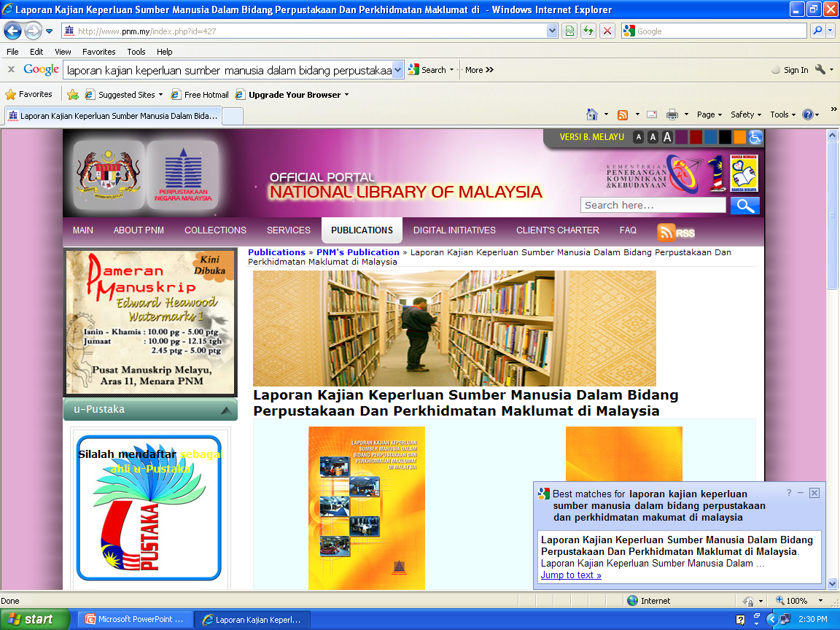

Slide 5
B. Kompetensi Staf Perpustakaan Akademik: Perpustakaan IPTA/IPTS: 2007 .
workshop organised by Perpustakaan UiTM, Jabatan Pembangunan Sumber Manusia UiTM, JALUMA (JK Latihan Bersama Institusi Pengajian Tinggi Malaysia)
identified competencies for all professional & support staff
identified generic competencies & specialised competencies
identified relevant courses or training required

Slide 6
C, Blueprint Kompetensi Pustakawan IPTA: 2008
follow-up from the 2007 project
identified competencies for all professional & support staff
identified generic competencies & specialised competencies
identified relevant courses or training required
identified competencies by division and from generic to specific
  Client
  Information technology
  Cataloging and classification
  Acquistions of books
  Journals and databases
  Information and reference service
professional staff – generic & specific
support – generic
support – generic & specific
range
  Professional qualifications S54, S52, S48, S44, S41, S27
  Support staff S26, S22, S17

Slide 7
D. Key Performance Indicators (KPI) for professional & support staff
different KPIs for different academic libraries
generic
specific to division/libraries
20 public university libraries formulating a standard KPI
27 & 28 June 2011 workshop in Kuala Lumpur
UM – management has decided on 4 generic & 4 specific KPI

Slide 8
How does the library and information science programmes in Malaysia support the need for these competencies?
Malaysia - library and information science programmes are run in universities
Ranges from diploma to PhD
1 private & 4 public universities

Slide 9
University | Undergraduate Programme | Postgraduate Programme
Universiti Industri Selangor (UNISEL) Industrial University of Selangor | - Diploma in Lib Science | - Masters in Education (Educational Resource Center Mgmt)
Universiti Islam Antarabangsa Malaysia (UIAM) International Islamic University Malaysia | - Bachelor of Mgmt Info Systems | - Master of Mgmt Info Systems - Master of Lib and Info Science - Ph.D. (Mgmt Info Systems) - Ph.D. (Lib and Info Science)
Universiti Malaya (UM) University of Malaya |  | - Master of Lib and Info Science - Doctor of Philosophy
Universiti Sains Islam Malaysia (USIM) Islamic Science University of Malaysia |  | - Bachelor of Sunnah Studies and Info Mgmt
Universiti Teknologi MARA (UiTM) MARA University of Technology - Faculty of Information Management | - Diploma in Info Mgmt - BSc in Info Studies (Hons): Lib & Info Mgmt - BSc in Info Studies (Hons) : Info Systems Mgmt - BSc in Info Studies (Hons) : Records Mgmt - BSc in Info Studies (Hons) : Resource Centre Mgmt | Master of Info Mgmt Master of Knowledge Mgmt - Master in Lib Science - Doctoral Degree in Info Mgmt

Slide 10
Malaysian Qualifications Agency. 2008. Programme standards for Library & Information Science. Petaling Jaya: MQA, 2008.
formulated to promote the development of academic programmes in the field of LIS from diploma to the doctoral levels. It includes specific guidelines on programme aims and objectives, programme learning outcomes, programme design, admission criteria, student assessment, academic staff, educational resources and continuous quality improvement.
http://www.mqa.gov.my/garispanduan/standardsains.pdf

Slide 11
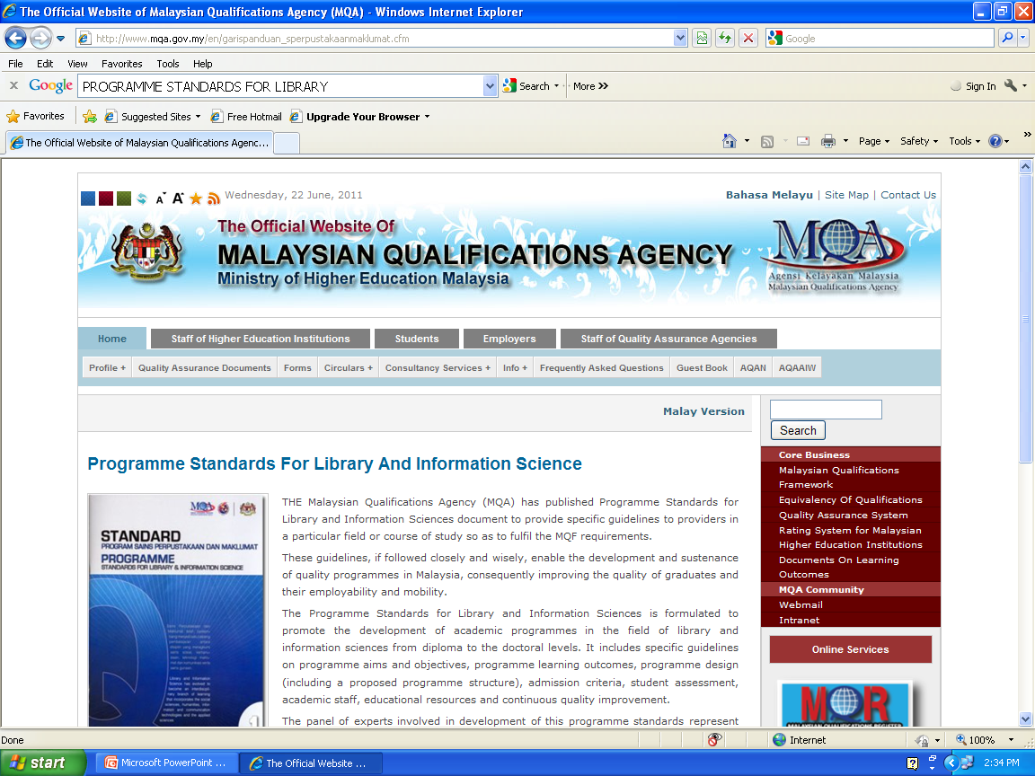

Slide 12
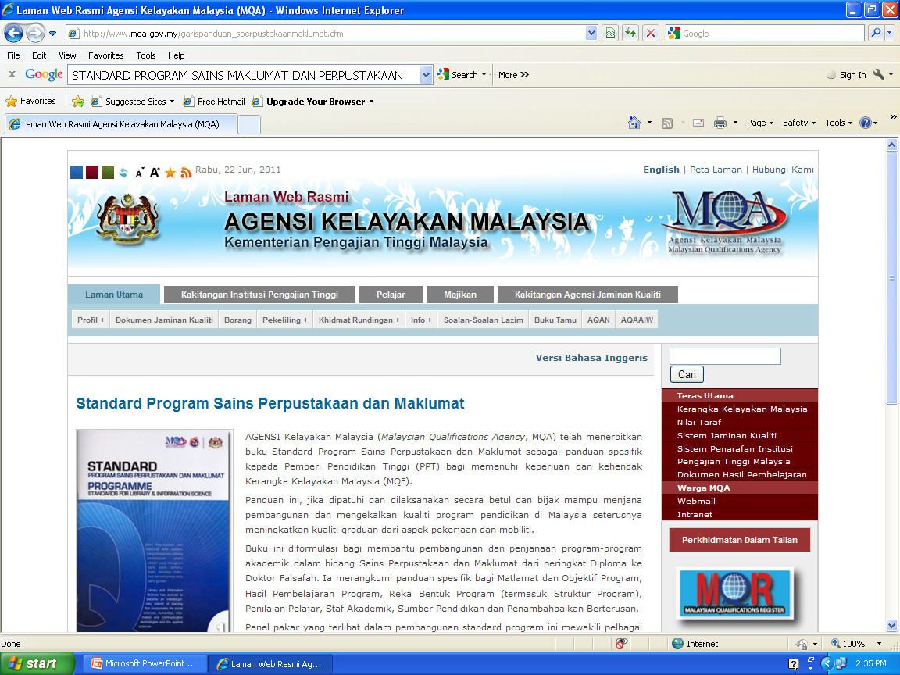

Slide 13
Aims and objectives
Learning outcomes
Programme design
Admission criteria
Student assessment
Staff
Educational resources
Continuous improvement
Appendix – Suggested subjects

Slide 14
DIPLOMA
90 credits
Components
  University requirements 15% - 25%
  Faculty requirements 75% - 85%
  Recommended core subject division
    Organisation of knowledge
    Management
    Sources and services
    ICT application

Slide 15
BACHELORS
120 credits
Components
  University requirements 10% - 15%
  Faculty requirements 60% - 75%
  Recommended core subject division
  Major - 75%
    Organisation of knowledge
    Management
    Sources and services
    ICT application
    Evaluation, research & synthesis

Slide 16
  Minor – 25%
    Electives 20%
    Practical training 5% - in a library or information agency with at least one Bachelor-qualified librarian

Slide 17
MASTERS
Components
  Core 50% - 60%
  Recommended core subject division
    Organisation of knowledge
    Management
    Sources and services
    ICT application
    Evaluation, research & synthesis
  Electives 40% - 60%
    Specialisation 30% - 40%

Slide 18
Structure
  Structure A = thesis only – minimum 1 year full time or 2 years part time
  Structure B = coursework (18 credits) & thesis
  Structure C = coursework only – 40 credits including Project paper or Case study
Fieldwork
  Required for students with non library and information science background

Slide 19
DOCTORATE
Coursework & thesis
  50% core + 50% electives
  Core – Statistics/Quantitative or Qualitative research/Progress report/ Seminar
  Examination (where applicable)
Thesis only

Slide 20
NEW DIRECTIONS
University of Malaya – granted research university status
Focus on research
Led to changes in structure of postgraduate programmes = at least 70% research within the programme
Students are eligible for research grants/scholarships

Slide 21
UNIVERSITI MALAYA – MASTER OF LIBRARY AND INFORMATION SCIENCE
Revised Programme Structure for Master of Library and Information Science (MLIS)
subject to MOHE’s approval
2011/2012
MLIS programme through 2 modes
  coursework and dissertation = a total of fifty-six (56) credits OR
  dissertation

Slide 22
Mode 1: Coursework & Dissertation
2 parts
Part I : four (4) core courses, three with three credits and one with four credit; and one (1) elective course of three credit hours.
Part II : forty (40) credits = involve research leading to the submission of a dissertation.

Slide 23
Core courses
  Reference and Information Literacy Services
  Organization of Information
  Research Methods in Library and Information Science
  Technologies for Information Management
  Dissertation
Elective courses
  Management of Library and Information Services
  Libraries, Information and Society
  User Needs and Behaviour
  Development of Information Collection
  Digital Libraries
  Web Publishing
  Special Topics in Library & Information Science I
  Special Topics in Library & Information Science II

Slide 24
Mode 2: Dissertation only
100 % research work leading to the submission of a dissertation.
Required to take a Research Foundations course during their first semester of enrolment.

Slide 25
THANK YOU

