Slide 1


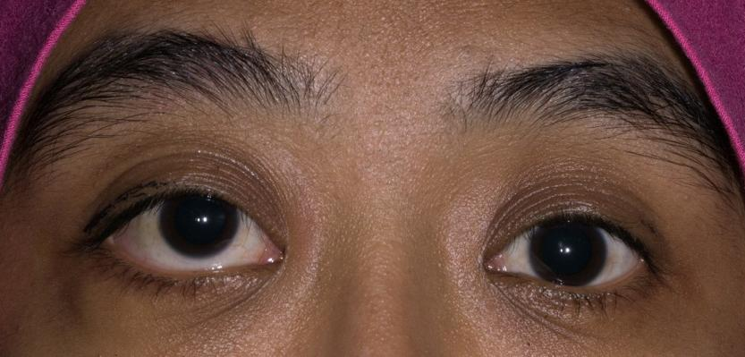
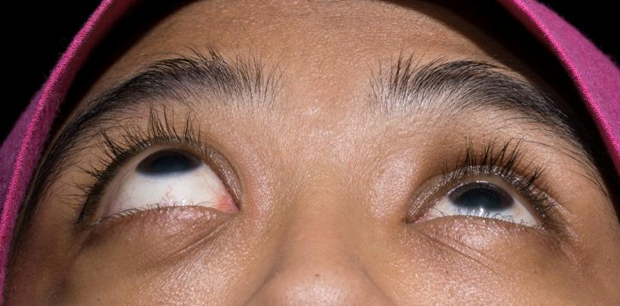
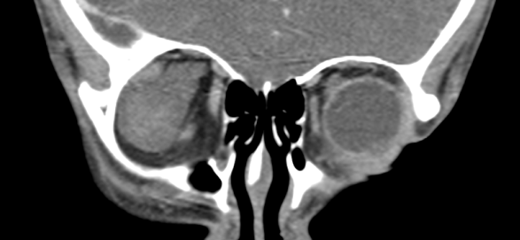
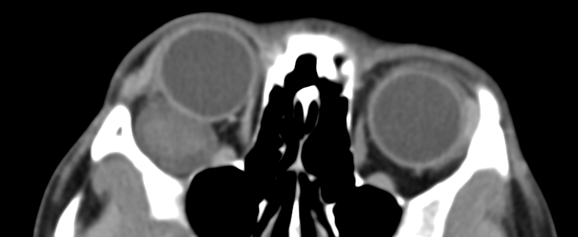
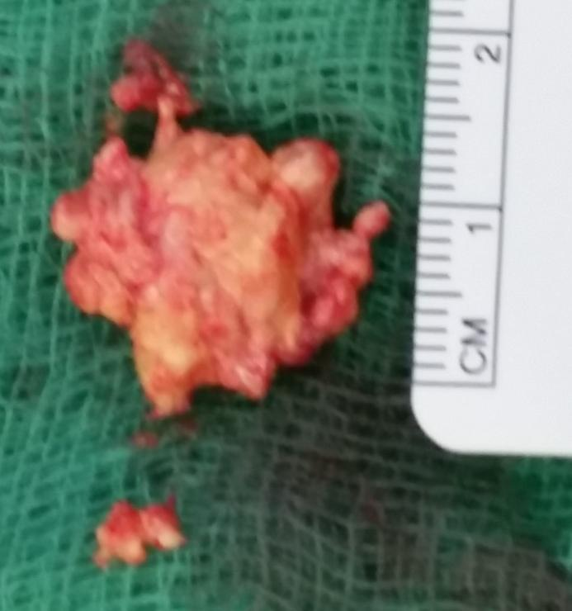
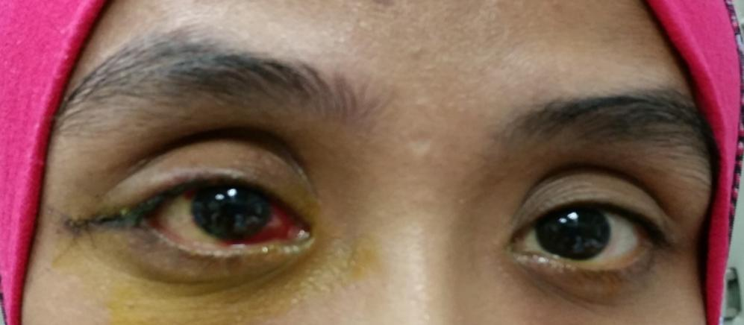
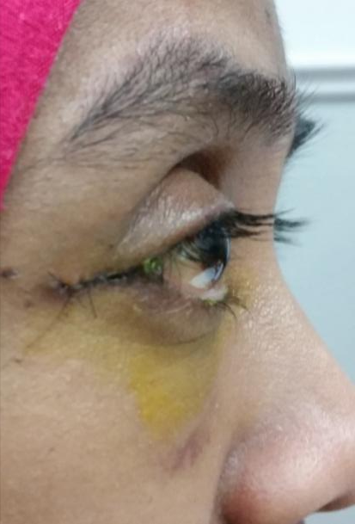
Rare Extraconal Orbital Mass;
a Benign Schwannoma
Azida Juana, Syaridatul Hikmah K, Ong CT
University of Malaya, Kuala Lumpur, Malaysia
Introduction
Schwannoma or neurilemmoma is a benign tumor of arising from Schwann cells of peripheral or cranial nerve. The orbit is a rare site for occurrence. Here we describe the presentation, findings and outcome of an orbital mass.
Case Report
A 23 year old female presented with slow, painless proptosis of the right eye without symptoms of diplopia or blurring of vision. Examination showed right eye non-axial proptosis and hypertropia with intact optic nerve function. There was no restriction of eye movement.
CT scan showed a well-defined and enhancing extraconal oval-shaped mass in the orbit which displaced the globe anteriorly.
Excision biopsy noted a well-encapsulated mass posterolateral to the globe which ruptured during manipulation demonstrating yellowish, cheesy-like content. Histopathological examination showed Schwannoma with Antoni A pattern.
Post-operatively, the proptosis resolved. Optic nerve function and ocular movements were intact.
Conclusion
Schwannoma is a cause of between 1% to 6.5% of all orbital tumors and usually arises from the sensory branches of ophthalmic division of trigeminal nerve. It commonly affects the superior orbit (supraorbital and supratrochlear nerves). Less commonly, it arises from a motor nerve such as the ciliary or oculomotor nerves.
The common presentation is painless insidious proptosis. The mass is usually well-defined, encapsulated, slowly progressive, unilateral and has a tan to yellow colour.
Two histological types of Schwannoma exist, namely
Antoni A (consisting of spindle-shaped cells arranged in interlacing fascicles with Verocay bodies) and Antoni B (sparsely cellular areas which are haphazardly arranged in a collagenous matrix). Antoni B areas appear hypodense and cystic on imaging.
In this case, the proptosis was approached systematically to rule out other causes such as infection, lymphoma and TED. Excision biopsy was done to confirm the diagnosis and to preserve optic nerve function.
Kashyap, Seema, et al. "Orbital schwannoma with cystic degeneration." Clinical & experimental ophthalmology 37.3 (2009): 293-298.
Khan, Sarah N., and Ali R. Sepahdari. "Orbital masses: CT and MRI of common vascular lesions, benign tumors, and malignancies." Saudi Journal of Ophthalmology 26.4 (2012): 373-383.

