Slide 1


M.A. Fazal
17th Asian Pacific Corrosion Control Conference
IIT Bombay, Mumbai, 27-30 January, 2016
Present Affiliation | Mechanical Engineering Department, University of Malaya
Academic Qualification | PhD
Area of Specialization | Corrosion and Coating Tribology Renewable energy
Achievements / Awards | Bright Spark Scholarship, 2010 Silver medal, ITEX 2011 Top 25 Hottest Articles in RSER journal, 2011
Paper no. 17038 | Corrosion of phosphorus bronze in different biodiesel blends and its remedial measures M. A. Fazal, B. Rathinee, H. H. Masjuki

Slide 2
CORROSION OF Phosphorus BRONZE in different biodiesel Blends and its remedial measures
Outline
Background
Specific Objectives
Experimental
Results and Discussion
Conclusions

Slide 3
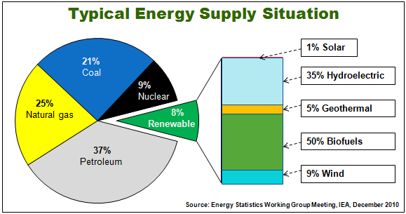
Depletion of petroleum diesel - A threat for future!
10³
Demand for biodiesel
Million Litters
Source: Global Biofuel Center, Feb. 2011

Slide 4
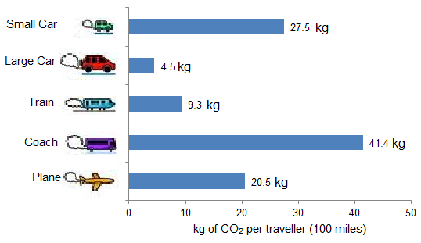
Emission from different automobiles - A threat for environment!
Emission of CO₂ per 100 miles for different vehicles:

Slide 5
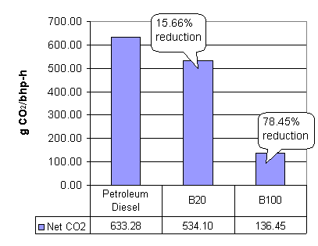


Biodiesel (B100) is environment friendly!
Use of biodiesel
Emission of CO₂ for different fuels.
Biodiesel has potential usage in:
Transportation
Power generation
Related industries

Slide 6
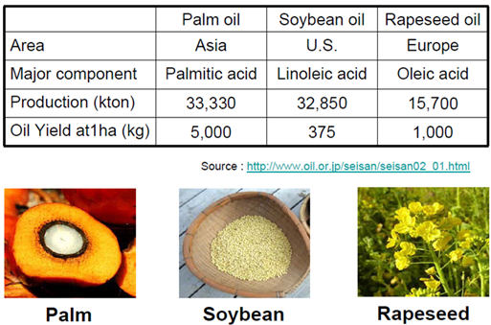
Biodiesel:
Reduced emission, improved lubricity; produced from renewable sources.
Can be combined at any level with petroleum diesel.
Major sources of biodiesel:

Slide 7
Compositional differences in diesel and biodiesel
Biodiesel:
Diesel:
  Esters: >96.5%
  (saturated and unsaturated)
  Other components:
  Free fatty acid, Moisture, Mono-, Di-, Triglyceride etc.
  Hydrocarbon mixture
  Aliphatic hydrocarbons: 75%
  (primarily paraffins including n, iso, and cycloparaffins)
  Aromatic hydrocarbons: 25%
Unsaturated components: ~ 40%
Unsaturated components: N/A
  Oxygen: 11 (%wt)
  Carbon: 77 (%wt)
  Hydrogen: 12 (%wt)
  Oxygen: 0 (%wt)
  Carbon: 87 (%wt)
  Hydrogen: 13 (%wt)
  Related concerns in biodiesel: (i) oxygen content
  (ii) Presence of unsaturated molecules

Slide 8
Major problems with biodiesel:
Corrosion of different automotive materials
Instability of fuel properties

Slide 9
CORROSION OF Phosphorus BRONZE in different biodiesel Blends and its remedial measures
Specific objectives:
To investigate corrosion of phosphorus bronze in different diesel-biodiesel blends
To characterize the fuel properties of blends upon exposure to phosphorus bonze.
To examine the effect of additives on the corrosiveness of palm biodiesel.

Slide 10
CORROSION OF Phosphorus BRONZE in different biodiesel Blends and its remedial measures
Outline
Background
Specific Objectives
Experimental
Results and Discussion
Conclusions

Slide 11
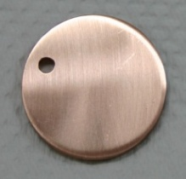
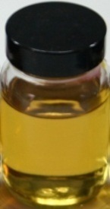
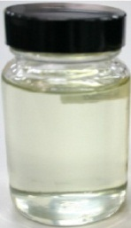
Experimental: Immersion test
Investigated metals:
Phophorus bronze
Diesel (B0)
Phosphorus bronze
Investigated Fuels:
Diesel (B0)
B20 (20% biodiesel in diesel)
B50
Biodiesel (B100)
Biodiesel (B100)
Investigated additives:
TBA & BTA

Slide 12

Sample preparation
Immersion test
Test parameters:
Fuels (B0, B20, B50 & B100)
Duration: 1440 h
Corrosion rate
Surface morphology
Fuel analysis
Weight loss
Corrosion rate (mpy)
=
OM
SEM
EDS
XRD
AFM
Induction period (IP)
Density

Slide 13
Outline
Background
Specific Objectives
Experimental
Results and Discussion
Conclusions
Results to be highlighted
Corrosion rate
Corrosion products
Fuel degradation

Slide 14
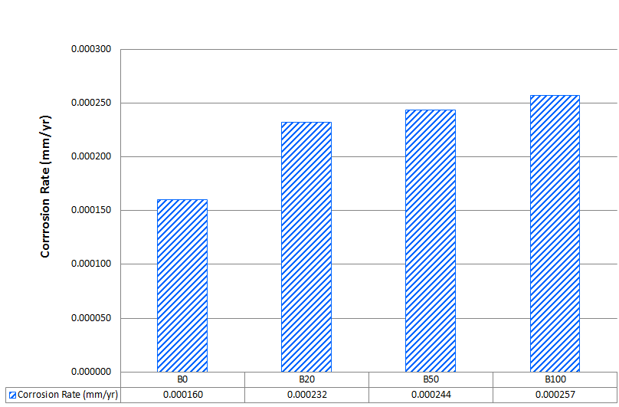
Results and discussion
Corrosion rate of leaded bronze in different fuels
Aggressiveness of blends increases with the increase of biodiesel.

Slide 15
Corrosion Rate | Fuel Without Additive (µm/yr) | Fuel with TBA additive (µm/yr) | Efficiency of TBA additive (%) | Fuel with BTA additive (µm/yr) | Efficiency of BTA additive (%)
B20 | 0. 232 | 0. 205 | 11.64 | 0. 202 | 12.93
B100 | 0. 257 | 0. 240 | 6.61 | 0. 234 | 8.95
BTA is more effective while copper is exposed for 1440 h in biodiesel.
15

Slide 16
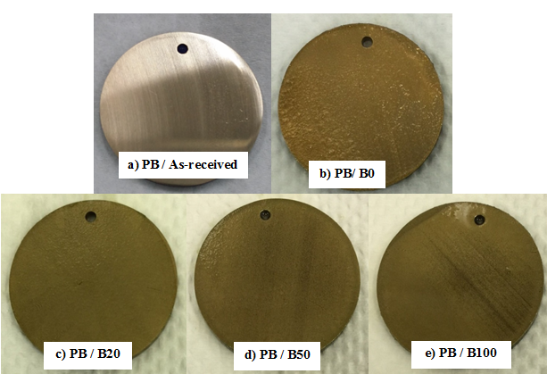
Findings:
Appearances of the coupons have been changed after exposure to diesel and biodiesel blends.
This could be attributed to the formation of corrosion products on the metal surfaces.
16

Slide 17
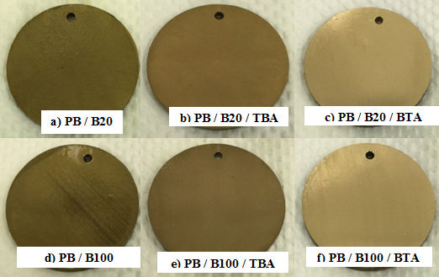
Findings:
In absence of additives (TBA and BTA ) PB in B20 and B100 forms dark corrosion product. Presence of additives makes the appearances lighter.
BTA is effective in reducing the formation of dark corrosion products.
17

Slide 18
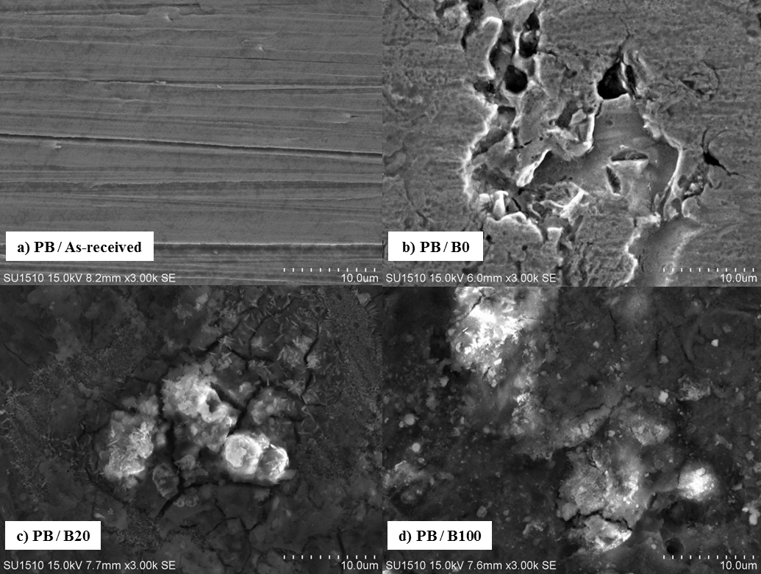
SEM results
Findings:
Scratches are available on as-received coupon but not in fuel exposed surfaces.
Coupon in B100 is degraded more.
18

Slide 19
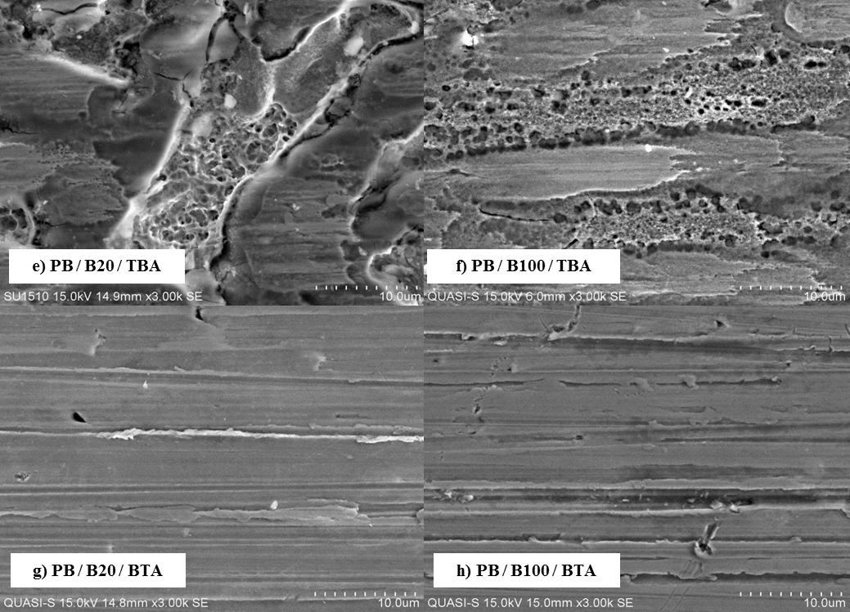
SEM results
Findings:
BTA doped biodiesel and its blend cause less corrosion attack on PB.
Corrosion attack in BTA doped B100 is comparatively less than that in B100 and TBA doped B100.
19

Slide 20
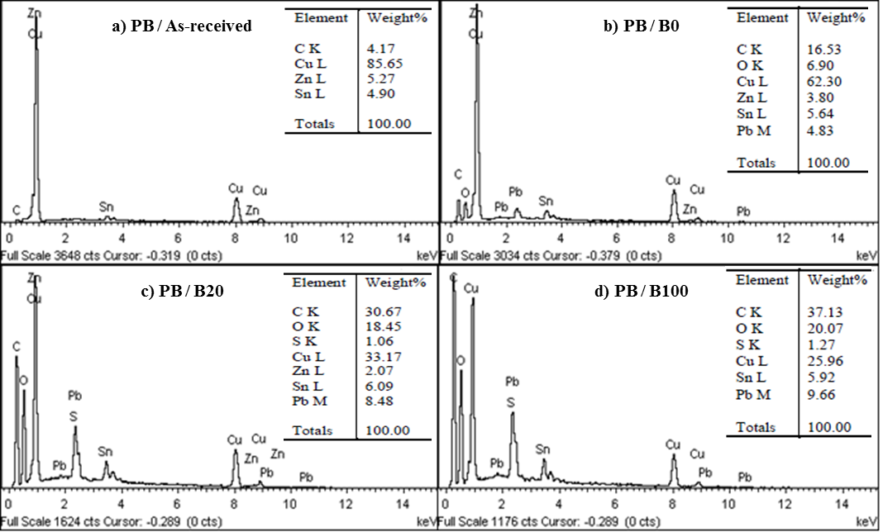
EDS results
Findings:
Presence of oxygen on metal surface increases with the increase of biodiesel concentration. This suggests that oxide compounds are comparatively formed more in B100.
20

Slide 21
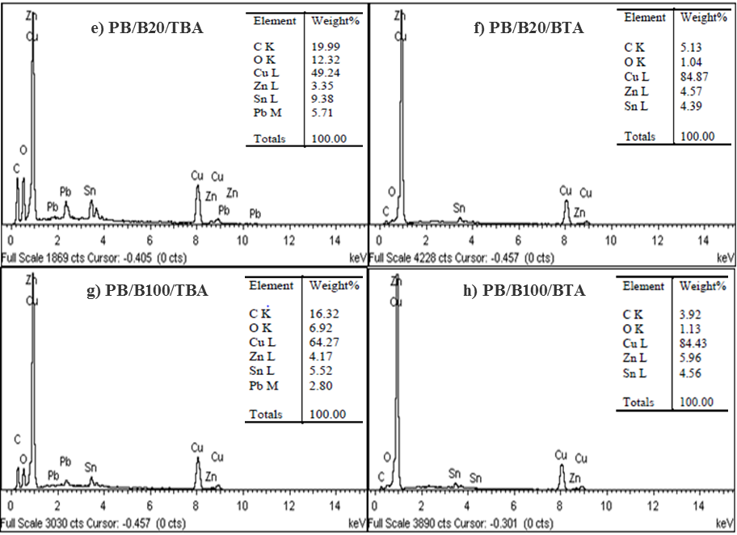
EDS results
Findings:
Less oxygen is found when sample is exposed to BTA doped biodiesel.
21

Slide 22
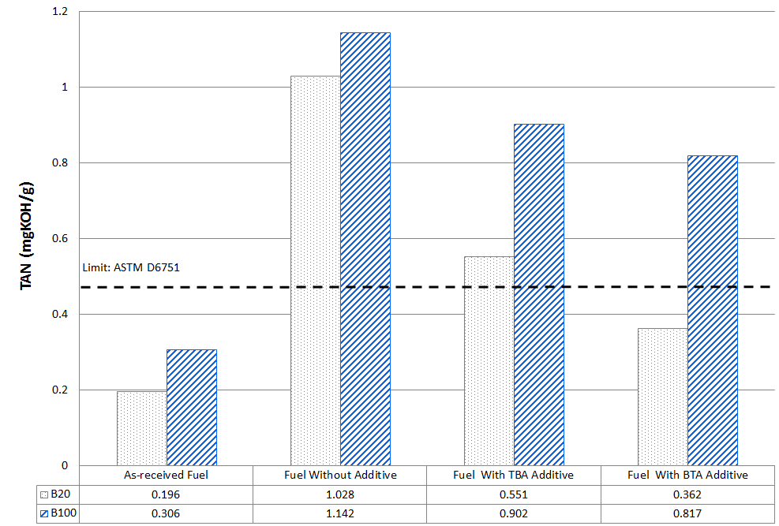
Even after adding additives, TAN crosses the limit.
22

Slide 23
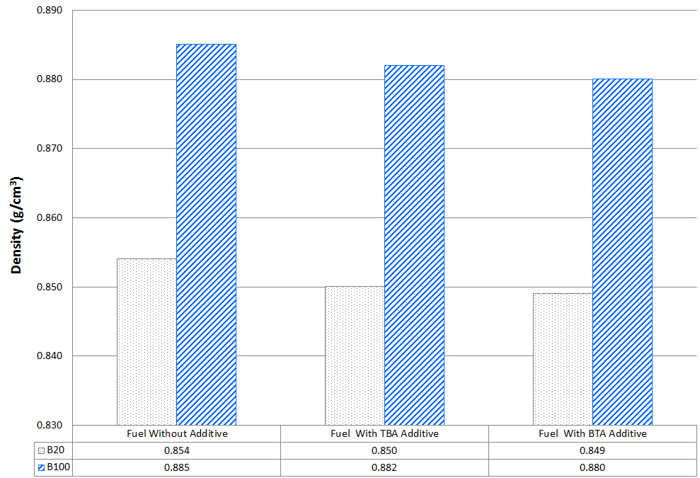
Density is not significantly changed.
Within the limit given by EN 14214 standard

Slide 24
CORROSION OF Phosphorus BRONZE in different biodiesel Blends and its remedial measures
Outline
Background
Specific Objectives
Experimental
Results and Discussion
Conclusions

Slide 25
Conclusion:
The lowest corrosion rate was recorded in the B0 while the highest corrosion rate was recorded in the B100. The addition of corrosion inhibitor in biodiesel reduces the corrosion rate of phosphor bronze. Additive BTA shows a higher efficiency in inhibiting corrosion when compared to additive TBA.
TBA doped fuel does not provide sufficient protection to phosphor bronze when compared to BTA doped fuels that shows minimum corrosion attack and similar appearance to the as-received test sample prior immersion under SEM analysis.
There is an increase in the oxygen and carbon content on phosphor bronze coupons with increasing biodiesel in the fuel. This indicates that there is an increase in the corrosion compound formed on the sample surface. The increasing biodiesel content leads to the dissolution and oxidation of biodiesel to form free fatty acids, thus resulting in the instability of biodiesel.
The addition of corrosion inhibitors is capable to improve the corrosion resistance of phosphor bronze. BTA additive serves as a better and more efficient corrosion inhibitor in reducing the corrosion attack on phosphor bronze.

Slide 26
THANK YOU
Dr. M. A. Fazal
Email: fazal@um.edu.my
Department of Mechanical Engineering
University of Malaya

Slide 27
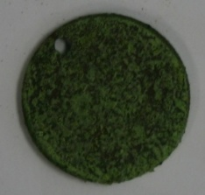
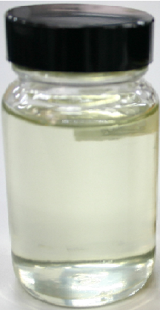
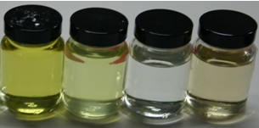
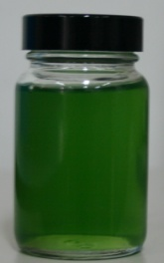

Esters
Cu / B100
BS / B100
Al / B100
CI / B100
As received Palm Biodiesel (B100)
At room temperature/1200 h
Increased acid and water content
Formation of Adehyde, ketone, alcohol
B100/Cu/80°C/1200 h

